Slide 1
Week 8 Presentation
Team 16
By: James Panhorst, Jibin Mathews, Josh Ramirez, Alex Holmes

Slide 2
Objectives
Develop an autonomous robot that can navigate racetrack and avoid obstacles
Must be able to:
Follow Metallic Tape (IPS: LJ18A3-8-Z/BX)
Avoid Obstacles (IR Sensor: GP2Y0A60SZ0F)
Detect/ proceed actions with corresponding colors (Color Light-to-Frequency TCS3200)
Green: Go
Blue: Slow Down
Red: Stop
Design Printed Circuit Boards (PCB) and utilize with project

Slide 3
Approaches for objectives
IPS Sensor needs to be adjusted to the right height
Corner Ramp
Is the positioning of IPS affected?
Is the ride height of the Rover 5 affected?
Alternative Path
How can the robot turn while still knowing to follow the metallic line using IPS?
More proximity sensors(Maybe 4)
Color Sensor
Positioning (Underneath, Behind, In-front)

Slide 4
Deliverables For Week 8
Implement functioning IPS Sensor detection code for movement.
Continue research on the code for the color sensor.
Continue to blueprint final rover chassis.

Slide 5
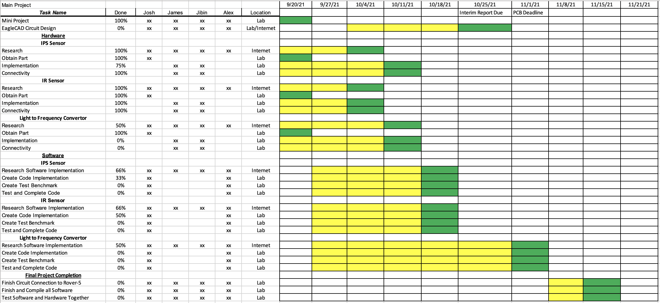
Gantt Chart

Slide 6
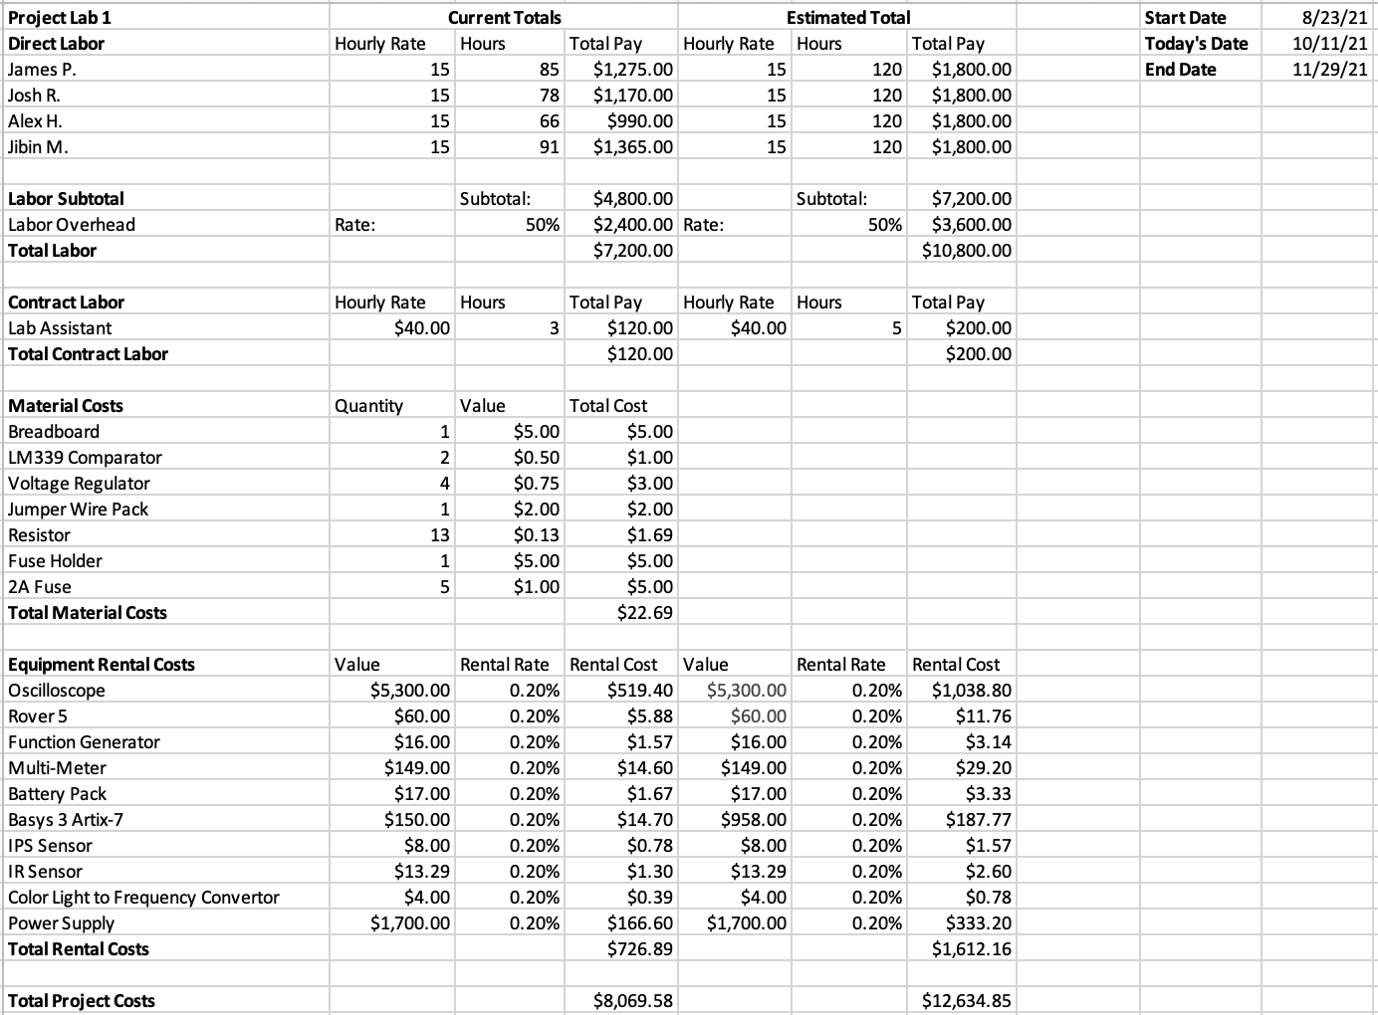
Budget Sheet

Slide 7
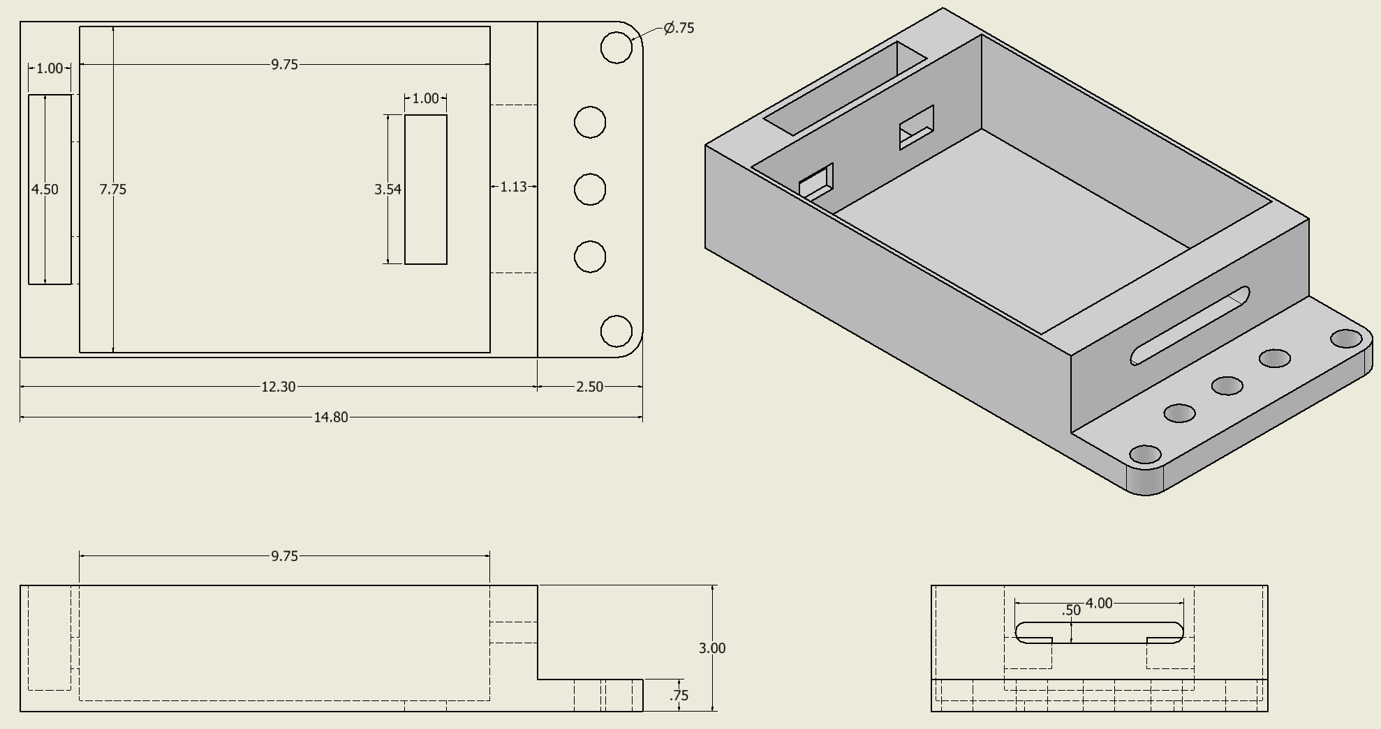
Rover 5 Base Model

Slide 8
IR Sensor Details
Utilized an LM339 comparator to compare the IR sensor output to a fixed voltage.
The fixed voltage is a result of a voltage divider, resulting in 2.0V connected to the inverting terminal of the comparator.
The non-inverting terminal is connected to the IR sensor output.
A pull-up resistor is connected from the IR output to 3.3V supplied from the Basys3 board.
As a result, when the IR sensor outputs more than 2.0V when an object comes within 20cm of it, the comparator outputs a signal high.

Slide 9
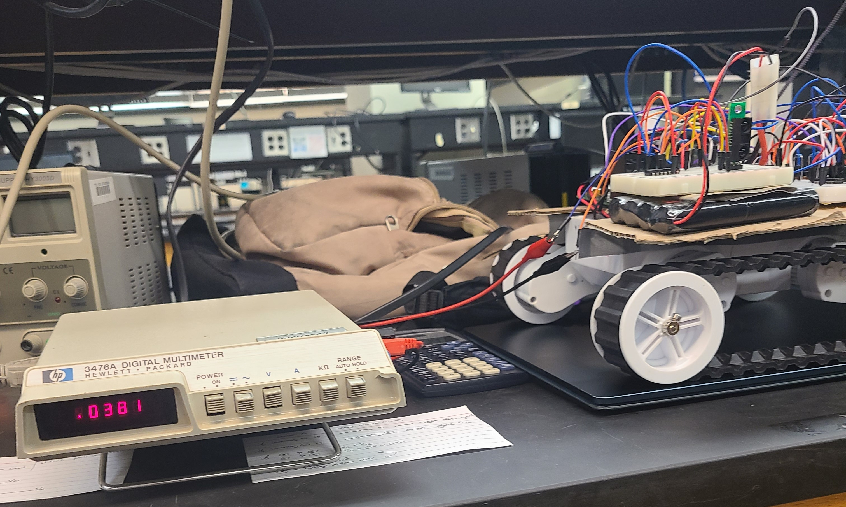
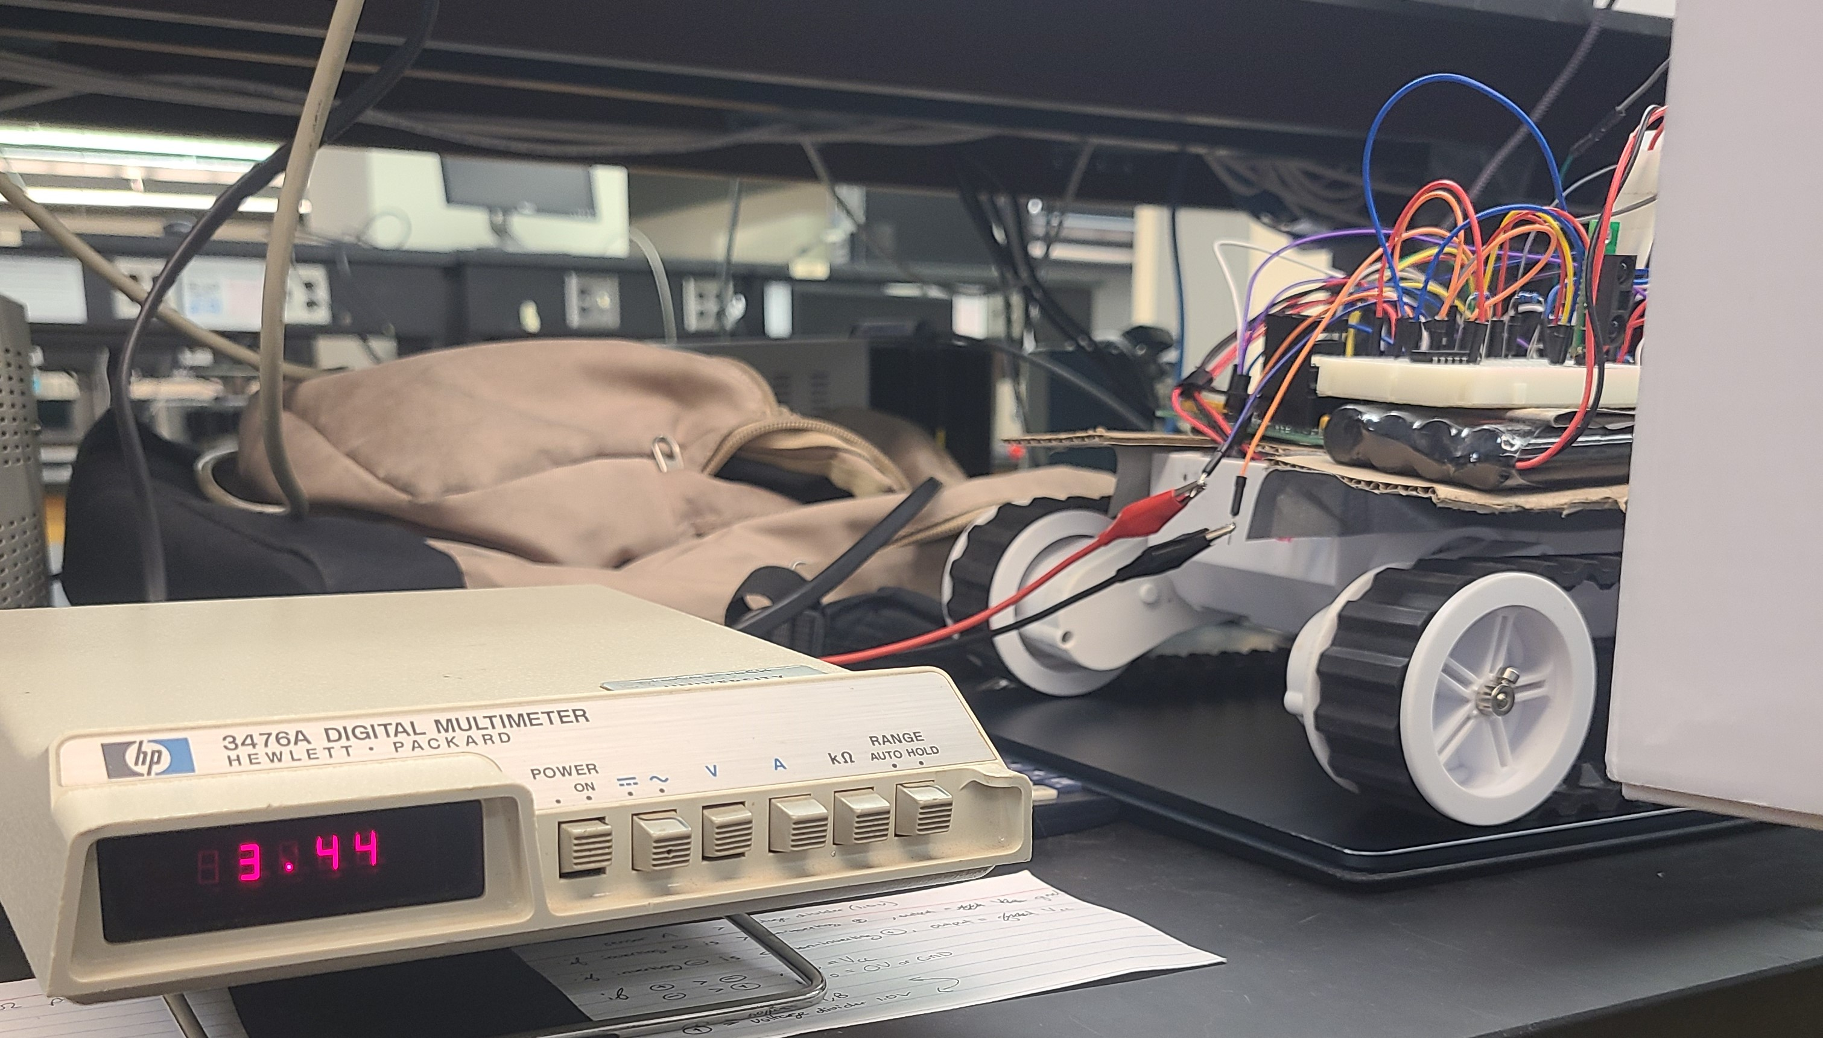
IR Sensor

Slide 10
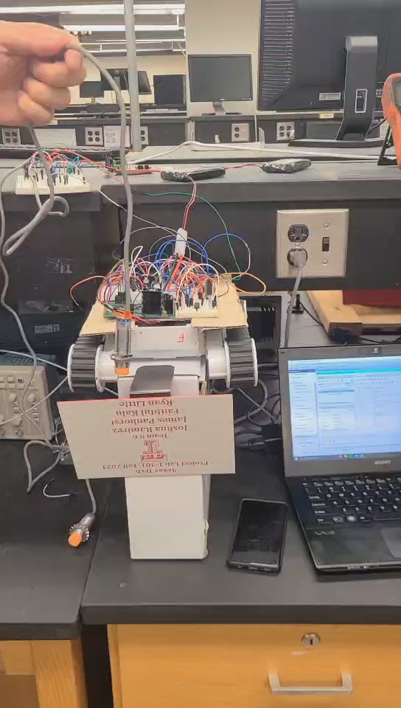
Active Working IPS/IR Sensor

Slide 11
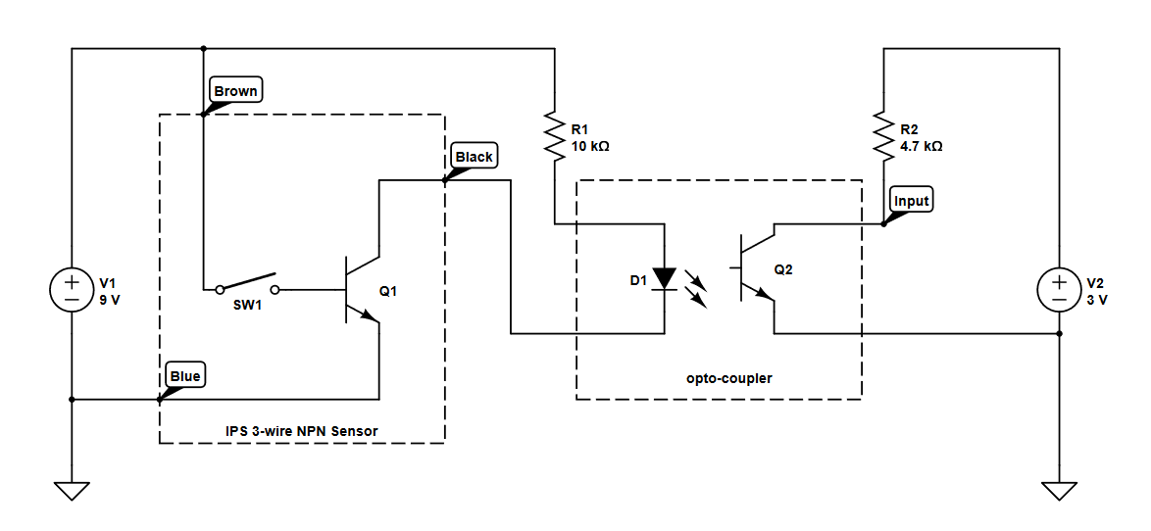
Inductive Proximity Sensor
-Used optocoupler to make signal output Logic High/Low.​
-Implementation for multiple IPS Sensors on breadboard.
[5] (IPS Optocoupler 2019)

Slide 12
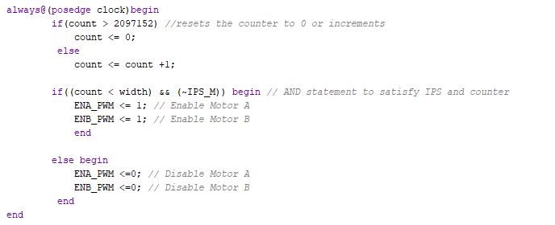
IPS Coding Portion (Active IPS)

Slide 13
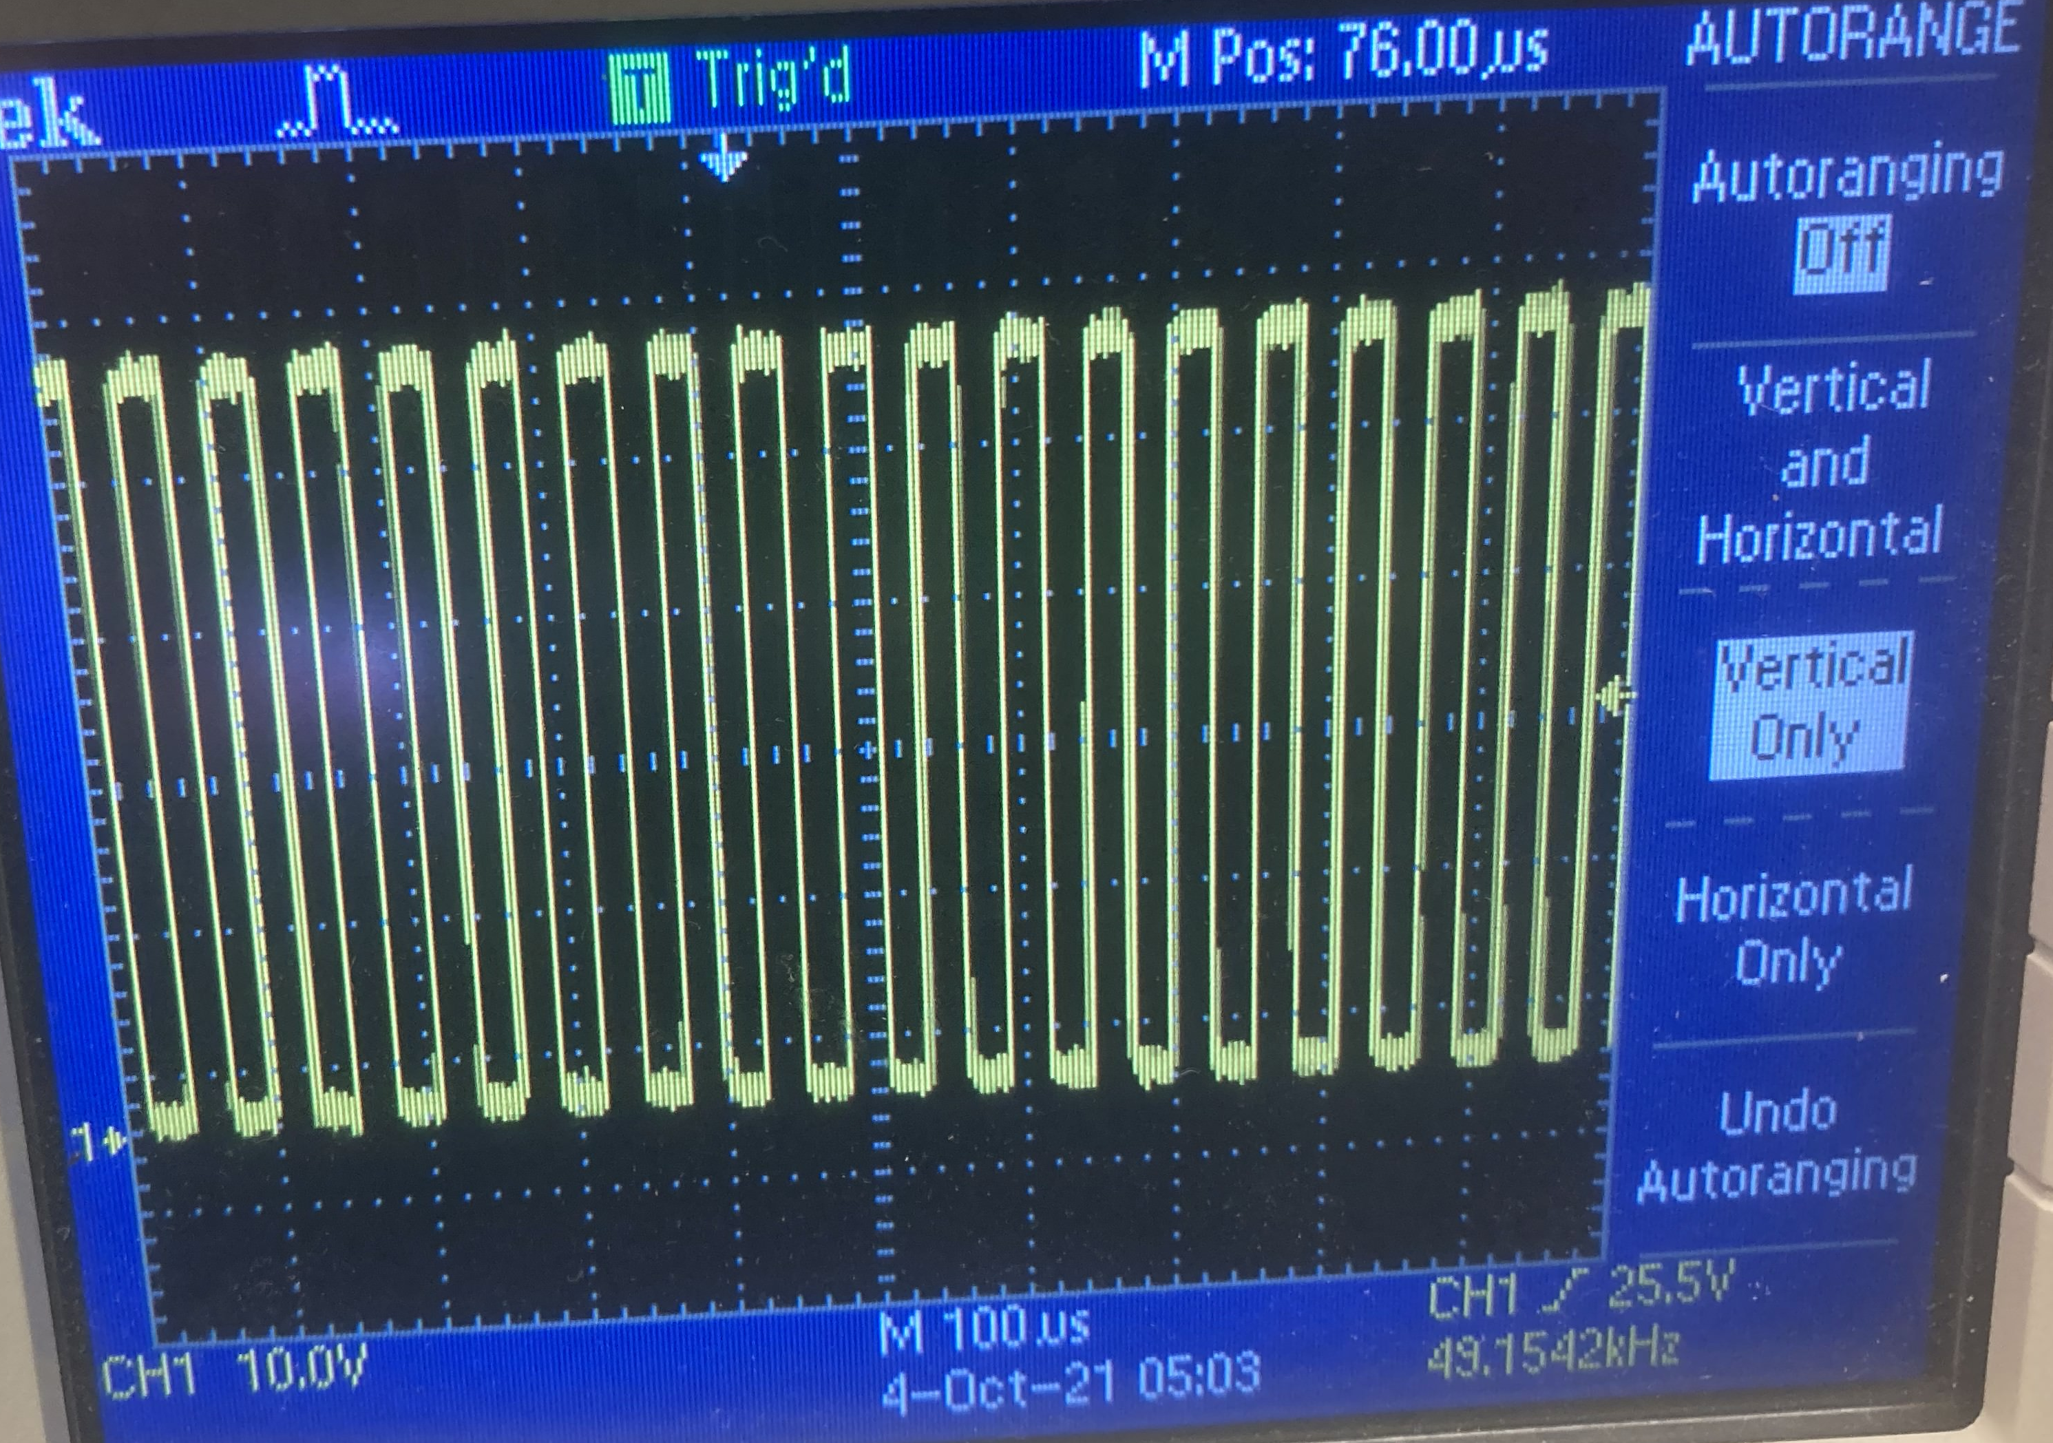
TCS3200 frequency

Slide 14
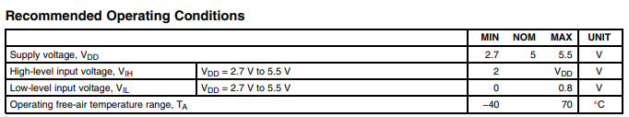
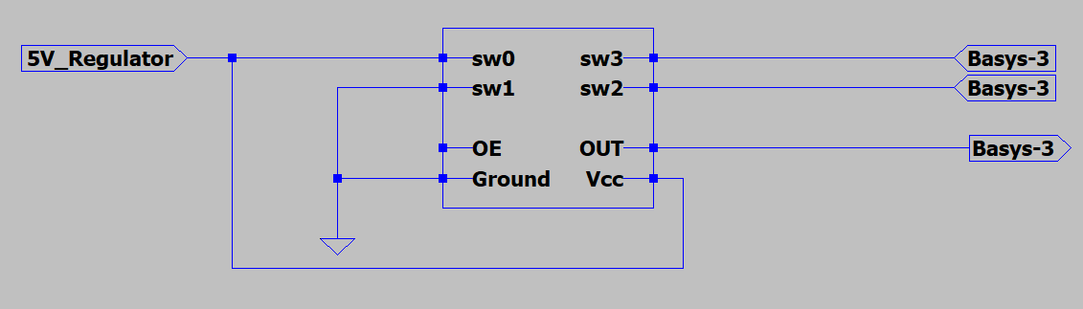
Wiring
https://www.mouser.com/catalog/specsheets/tcs3200-e11.pdf

Slide 15
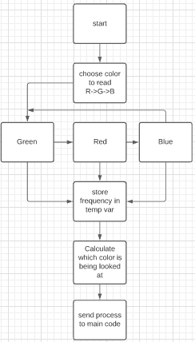
Color Sensor Logic

Slide 16
Next Week’s Deliverables
Finish testing and implementing code for the IR sensor.
Finish software implementation for the IPS Sensors.
Make improvements/ changes to the trial base and print (3-D printer/wood)
Implement IPS and IR Sensor mounting to the base

Slide 17
References
[1] IR Sensor (GP2Y0A60SZ0F) datasheet. https://www.pololu.com/file/0J812/gp2y0a60szxf_e.pdf.
[2] IPS Sensor (LJ18A3-8-Z/BX). http://files.microjpm.webnode.com/200003722-858c88684b/Condutive%20Proximity%20Switch%20Series.pdf
[3] Color Light-To-Frequency Converter (TCS3200) datasheet. https://www.mouser.com/catalog/specsheets/tcs3200-e11.pdf
[4] TCS3200 Tester Code. https://randomnerdtutorials.com/arduino-color-sensor-tcs230-tcs3200/
[5] Clark, S. (2019). Ips Optocoupler.

Slide 18

Questions

